Slide 1
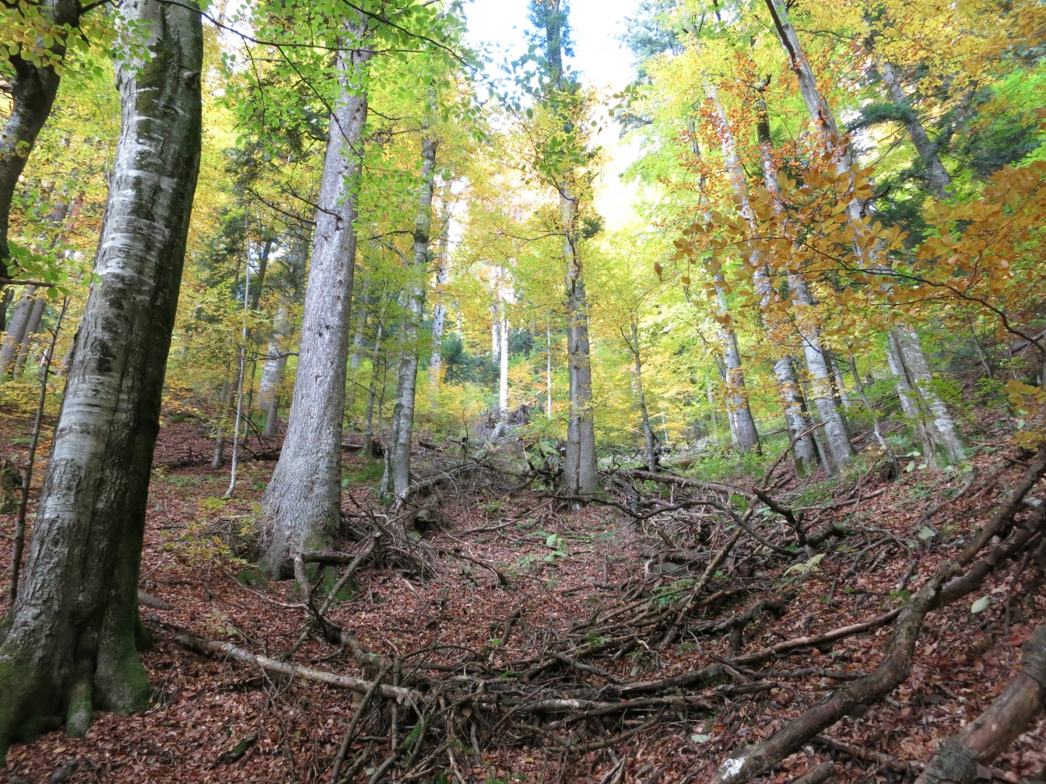
Radu Vlad - WWF Romania
National specific procedures to ensure Old Growth Forest protection
Challenges, achievements & way forward
Notes:
There are many reasons why a forest could represent a high conservation value.
They might:
Shelter significant concentration of biological diversity;
Basic ecosystem services in critical situations;
Provide resources fundamental for satisfying the basic necessities of local communities;
Critical for the preservation of the cultural identity of a community or an area;
Constitute a rare or endangered forest ecosystem as a type /association, etc.
OR because its naturalness - and so we reach to Old Growth Forest
A high degree of naturalness, form mainly due to natural influences is not only rare nowadays but also very important from a scientific, biodiversity conservation, fighting against climate change, recreational, and not the least cultural identity point of view.
But the scope of the PPT is not to raise awareness of the importance of this European Heritage – something that most probably it is clear now for everybody here.
It is rather a try to present our perspective about The Process of protecting Old Growth Forest in Romania, with its achievements & challenges and of course the way forward considering the need to complete the mission of preserving this value.

Slide 2
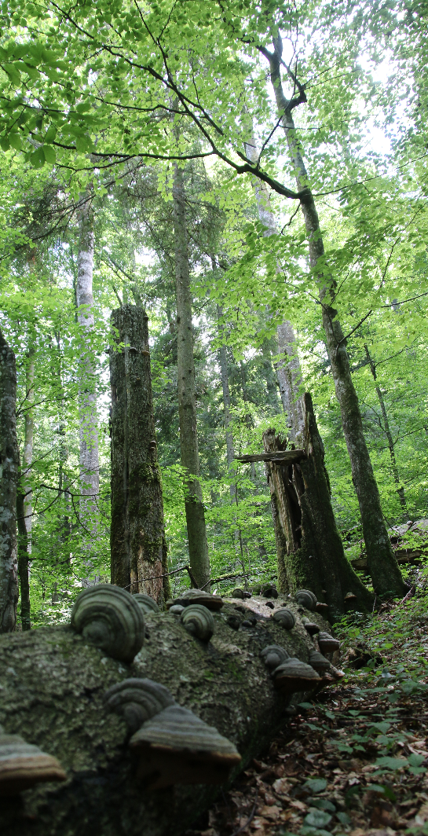
The Naturalness of the Forest ecosystem
Naturally regenerated forests
Structure and native tree species
Natural processes - unique ecological features
No significant human influence
very old forests that emerged and developed under the influence of natural factors where the structure, diversity and ecosystem processes have remained untouched by significant direct or indirect human influence
Notes:
The Naturalness of the Forest ecosystem is capture by different concepts: primary, primeval, virgin, cvasi-virgine, natural or old growth forest.
And in all these concepts there are some key common features in detailing the Naturalness:
Naturally regenerated forests
Structure and native tree species
Natural processes - unique ecological features
IN Romania, particularly regarding OGF concept: NO SIGNIFICANT human influences is captured – and this to make a difference with the managed forest which were deliberately led to achieve similar structure by responsible forest management practices (e.g. long rotation period or selection system).

Slide 3
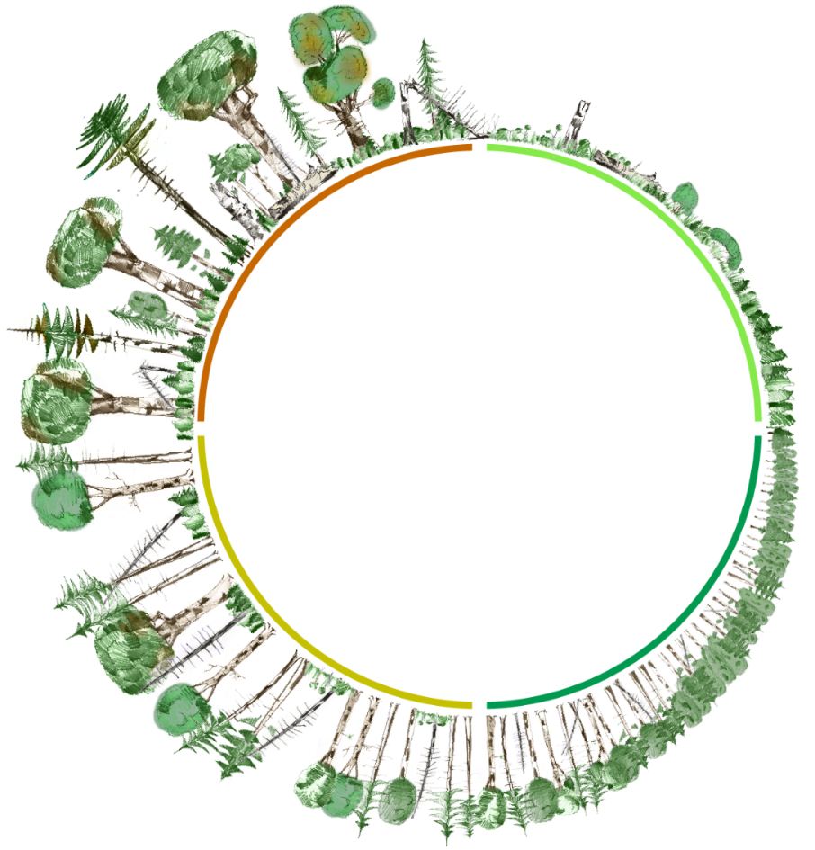
National specific procedures to ensure Old Growth Forest protection - challenges & achievements way forward
Definition
Virgin forest
Cvasi-virgin forest
Criteria & indicators for their rapid assessment:
Criterion Naturalness:
Species composition;
Structure;
Ages;
Deadwood;
Quantifying “insignificant” human influence.
Criterion Area & Delimitation
Area of forest plot stand;
Shape of forest plot stand and soil;
Surrounding boundaries
Notes:
In Romania, in terms of naturalness, and considering the national specific
Old-Growth Forests were considered the forests that have developed structures and are composed of species similar to old primary forest.
That is how were define:
Virgin forest: formed and developed exclusively under the action of natural factors - no direct or indirect anthropogenic influence.
Cvasi-virgin forest: where they undergone visible anthropic changes but insignificant on the structure or ecosystem processes.
Very important! Criteria and indicators have been only established for their rapid identification and take into consideration the national specifics;
The reasons were:
to have an quick assessment in the field and operative evaluation of available data from forest management plans.
to act as a filter to exclude most of the situations in which these parameters could have been reached following active management process.

Slide 4
National specific procedures to ensure Old Growth Forest protection - challenges & achievements way forward
Overview
Notes:
Aiming to have a better understanding of the facts, here is brief overview of the main milestones of the process of protecting the Old growth Forest in Romania (quickly go through these point).

Slide 5
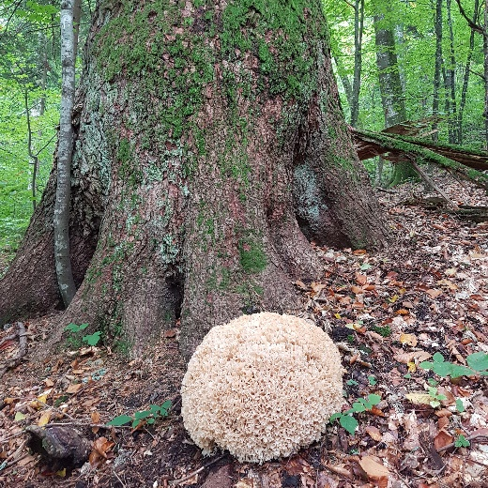
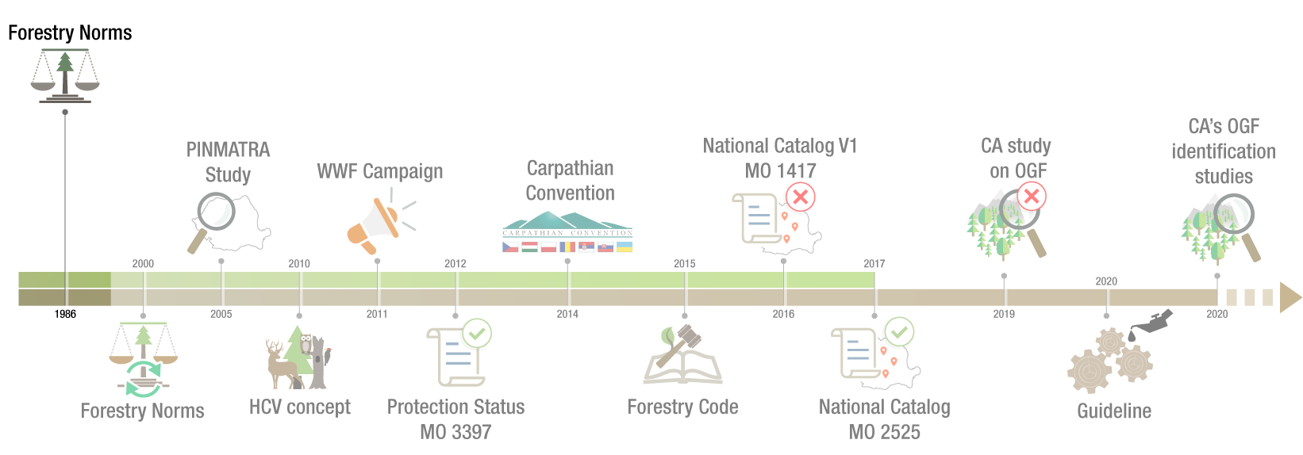
Forestry Norms
1986
the academic environment draws attention to their importance
formal recognition of OGF importance
functional category 1-5J
no clear identification criteria
no strict protection regime
Notes:
1986 – Forestry Norms
Achievement:
The academic environment draws attention to the importance of protecting this heritage
Formal recognition of OGF importance by imposing a new Functional category 1-5J; at that time about 25% of the forests (at that time belonging to the state) were under protection (TI - TII ) having different protection roles.
BUT:
→ NO clear identification criteria are established
→ NO strict protection regime imposed

Slide 6
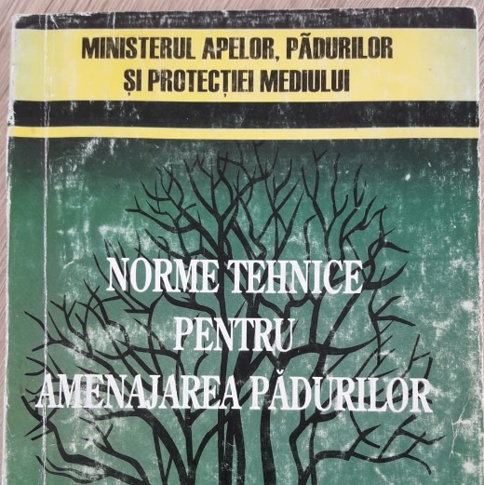
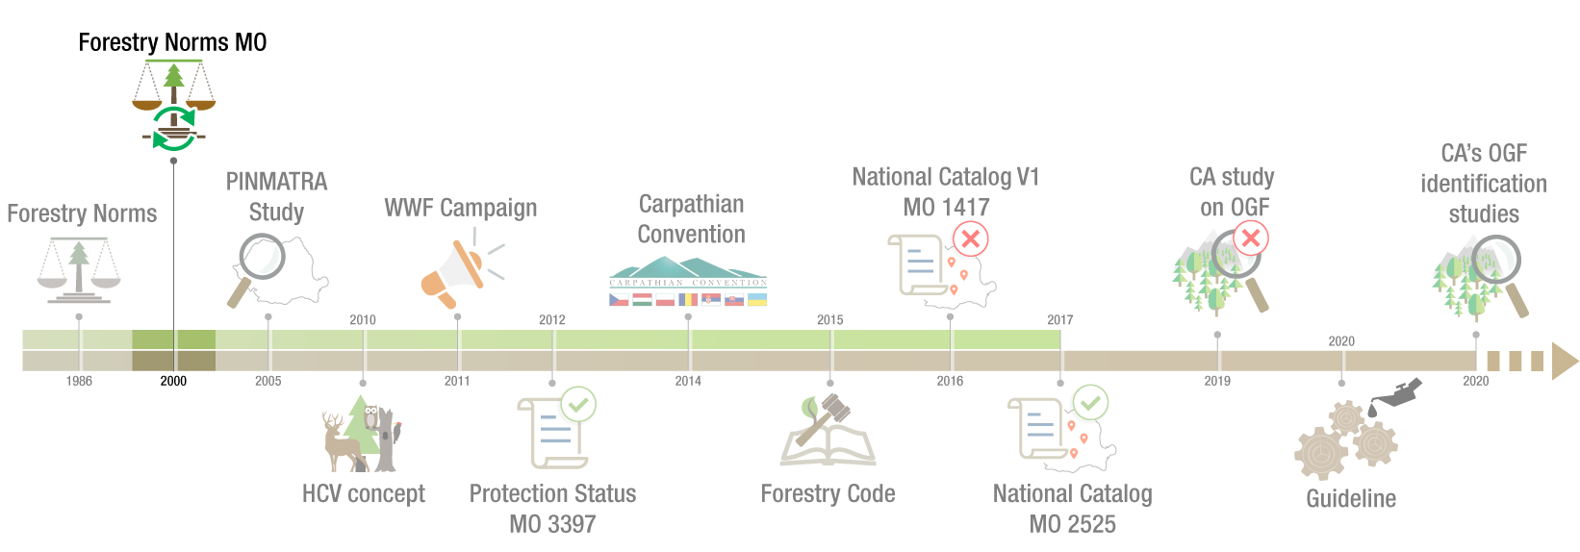
Forestry Norms
2000
same functional system;
thousands of hectares are already preserved
the academic environment draws attention to the importance
still no clear identification criteria
increasing the risks in light of the chaotic restitution process;
Notes:
2000 – Forestry Norms
Succes:
pretty much the same norms;
thousands of hectares are already preserved
the academic environment continue to draws attention to the importance of protecting this heritage
BUT:
→ still no clear identification criteria established
→ threats are increasing due to a “chaotic” ownership restitution process;
→ “chaotic” since it was not “restitution in integrum” after having in place an adequate legislative framework adapted to this new situation; and in this context the new small owner became immediately outlawed.

Slide 7
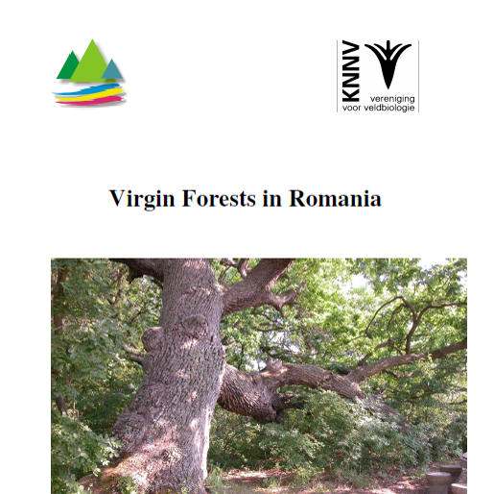
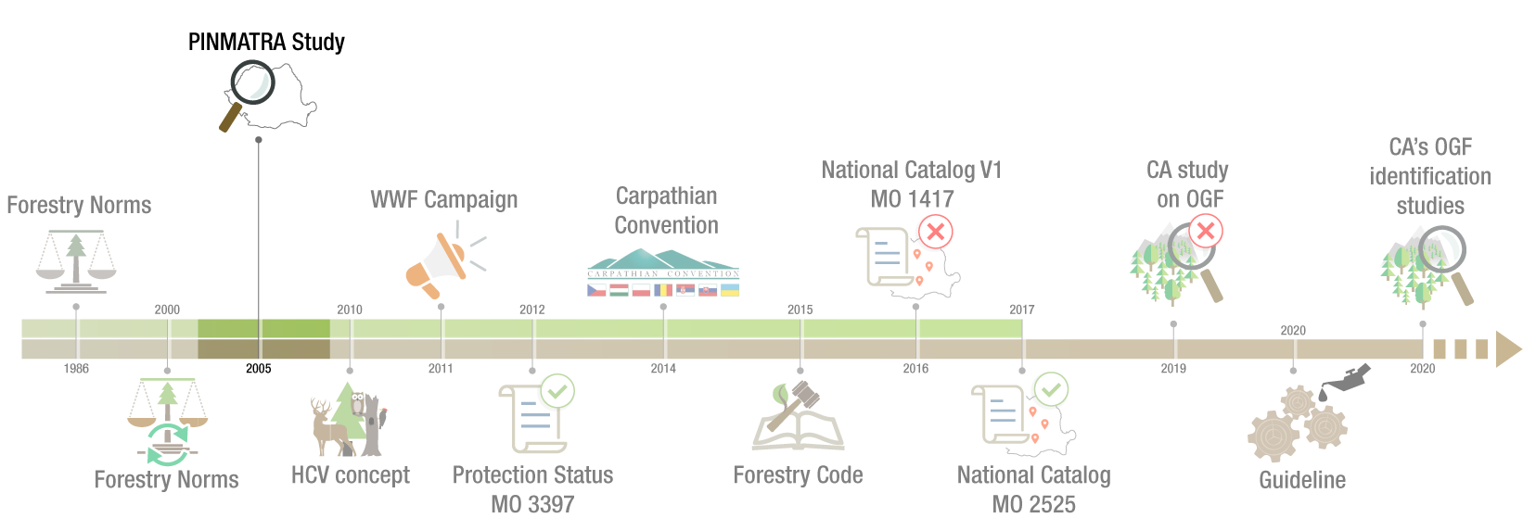
PINMATRA Study
2005
detailed identification criteria and indicators;
performed using centralized ICAS database on all FMPs
designed to support the designation process of Natura 2000 sites (> 80% became part of the Nature 2000).
preliminary assessment - the study is more a kind of desktop research
final results are not formally approved by the ICAS scientific council;
results are not fully transparently publish;
decision makers are not informed.
Notes:
2005 – Pinmatra Stydy:
started in 2001 and funded by the Programme International Nature Management of the Dutch Ministries of Agriculture
the study offer detailed criteria and indicators for identification (regionally harmonized: RO-BG-UA-SK);
it is a study performed by ICAS (National Forest Research Institute) and using ICAS database (unique & last centralized structured description of forests for every single forest sub-compartment at the national level – before accelerating the restitution process)’
the results of this project supposed to support the designation process of Natura 2000 sites (as a result > 80% of the areas will became part of the Nature 2000 network).
BUT:
→ the study is more a kind of desktop research a preliminary assessment
→ many of the area were not assessed in the field and furthermore the GIS layer has a relative accuracy.
→ therefore many areas included never meet the criteria but on same time there are other representative OGF areas that are not included in the study.
→ consequently the study’s results are not approved by the ICAS scientific council;
→ results are not fully transparent;
→ decision makers are not formally informed.

Slide 8
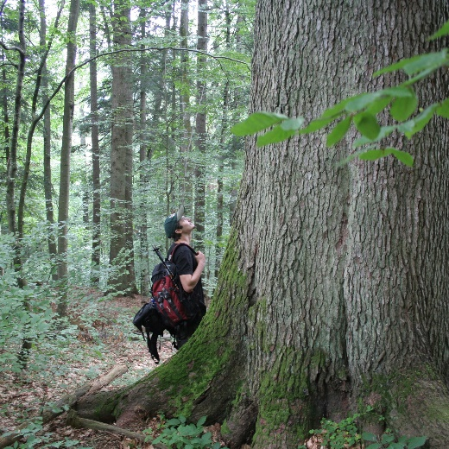
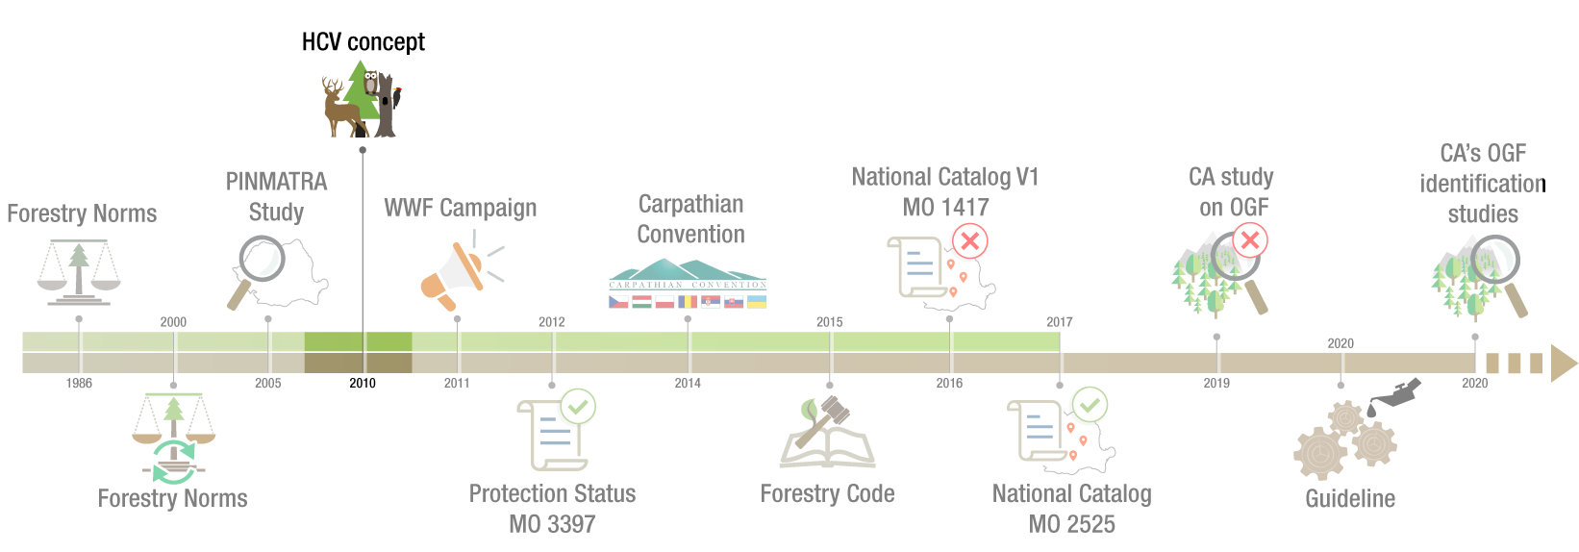
HCV concept
2010
criteria and indicators harmonized with the PINMATRA ones;
thousand of ha are protected on a voluntary basis through FSC® certification
> 3000 only in WWF PCAs;;
voluntary mechanism
there are few FSC® certified areas
Notes:
2010 – High Conservation Value Forest Concept
Introduce by FSC certification, provide:
Criteria and indicators harmonized with the PINMATRA ones;
thousand of ha are protected on a voluntary basis through FSC certification
over 3000 only in WWF priority conservation areas;
BUT
→ FSC is a voluntary mechanism
→ there were few FSC certified areas at that time

Slide 9
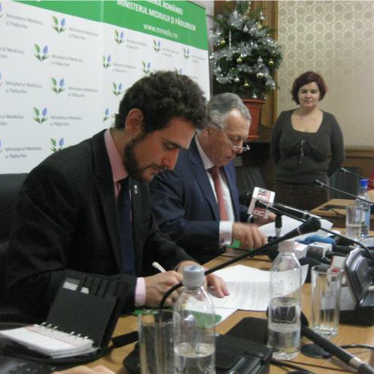
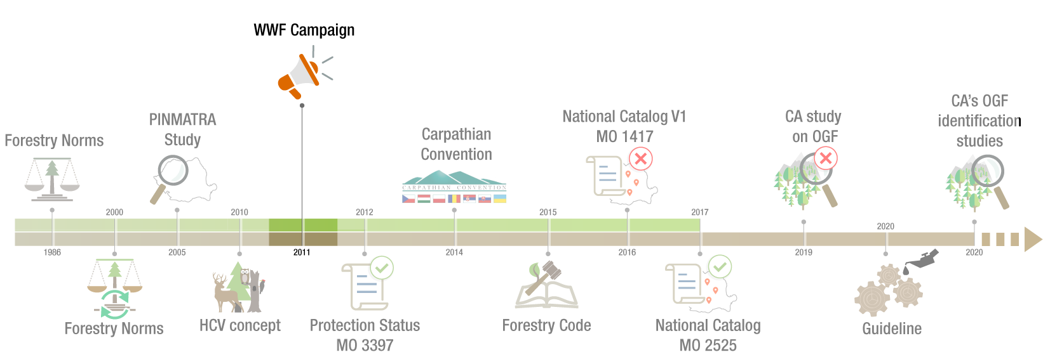
WWF Campaign
2011
petition supported by 100.000 signatures in a month;
CA assume to amend the Forest Norms to ensure their protection;
MoU for establishing the National Catalogue of Virgin and Cvasi-virgin Forests – as an evidence and management tool to protect OGF.
Since it was not a clear identification of the OGF the only chance to speed up the process was to make it more transparent and participatory - to allow interested stakeholders to bring their contribution.
Notes:
2011 – WWF Campaign for OGF protection
High interest of the society for protecting these forests:
a petition was supported by over 100.000 signatures in a month only;
Competent Authority (CA) assume to amend the Forest Norms;
WWF signed a MoU with CA for establishing the National Catalogue of Virgin and Cvasi-virgin Forests – as an evidence and management tool to protect OGF.
Since it was not a clear identification of the OGF the only chance to speed up the process was to make it more transparent and participatory - to allow interested stakeholders to bring their contribution.
Ideal situation would be to have a full inventory and immediately put them under protection, but it was not the case! Romania didn’t know where its OGF are! We discuss about the PINMATRA study: it seems it was more like a desktop research (a useful one but with many question mark in term of its accuracy)

Slide 10
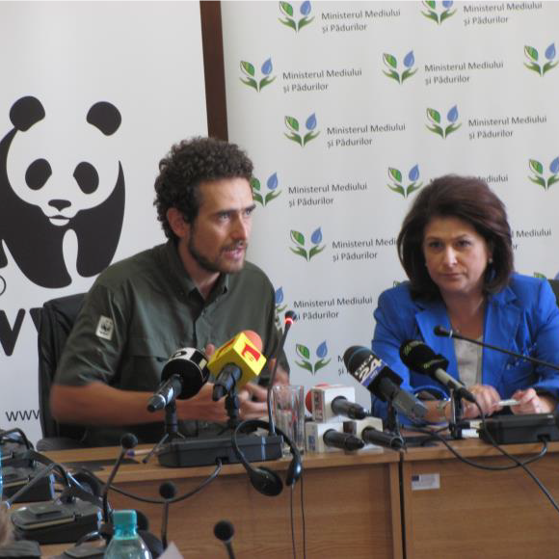
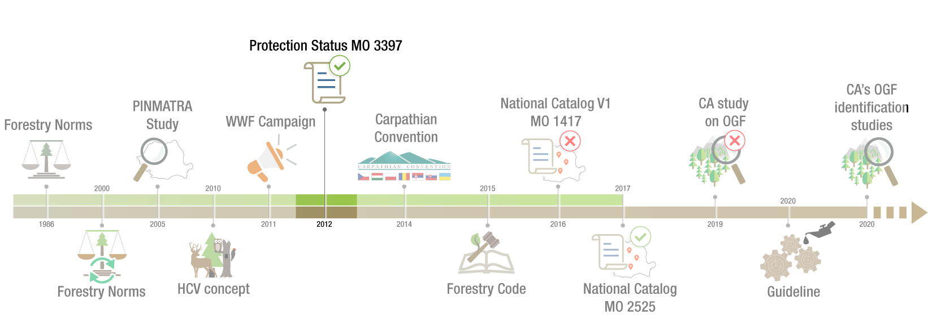
Protection Status – MO 3397
2012
Participatory & transparent process for setting up the identif. criteria;
Strict protection regime is enforced
Criteria and indicators harmonized with PINMATRA
FMP revision is the only way to ensure OGF protection
A moratorium is established for PINMATRA areas – but only for those with a production role (15%)
PINMATRA results are is not officially published - moratorium cannot be applied
NO functional compensatory mechanism for private owners.
Notes:
2012 – OGF reaches their Protection status in the legislation
Succes:
Strict protection regime is enforced
It was a participatory and transparent process for setting up the identification criteria (engaging NGOs, RO Academy, National Research Institute, Forestry Universities and other key stakeholders);
Criteria and indicators are harmonized with the PINMATRA ones;
The legal procedure for identification and establishing protection regime are the updating forest management plan (FMP) procedure (this is happening every 10 years);
BUT
→ FMP revision is the only way to ensure OGF protection (and this is a slow process)
→ A moratorium is established for PINMATRA areas – but only for those with a production role (covering about 15% of the area included in PINMATRA)
→ PINMATRA results are not officially published - moratorium cannot be applied!
→ As a conclusion: protection process just started without really knowing where are the Romanian’s OGF; and with an inapplicable moratorium to ensure protection of PINMATRA Study. AND NO functional compensatory mechanism for private owners.

Slide 11
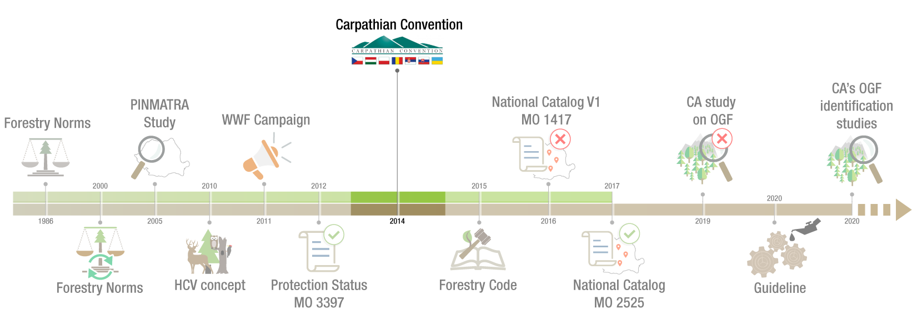
Carpathian Convention
2014
identification criteria are established for virgin forest
developed by groups of experts
finally assumed by the official representatives of the Carpathian countries
very much in line with the RO legislation provisions
does not have legal levers to speed up the process in Romania.
Notes:
2014 – Conventia Carpati (Mikulov, Czech Republic)
Succes:
Identification criteria are established for virgin forest– those forest ecosystems that require a strict protection in terms of naturalness
developed by groups of experts is finally assumed by the official representatives of the Carpathian countries
very much in line with the RO legislation provisions
BUT:
→ The Carpathian Convention protocol does not have legal levers to speed up the process in Romania.

Slide 12
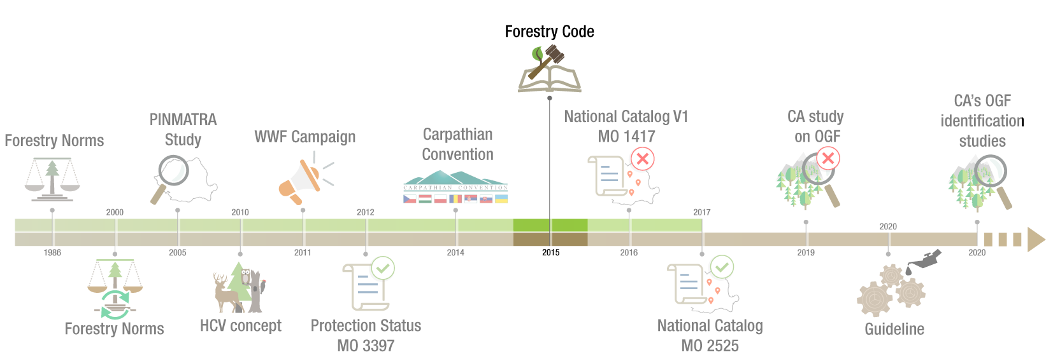
Forestry Code
2015
The protection of virgin forests is strengthened by law provisions;
Imposes the establishment of the National Catalog as a tool for evidence and management of virgin and quasi-virgin forests.
The legal procedures (to make the process more transparent and dynamic) must wait for the elaboration of a Ministerial Order
Notes:
2015 – Forestry Code
Succes:
The protection of virgin forests is now provided by law;
It is now imposed the establishment of the National Catalog as a tool for evidence and management of virgin and quasi-virgin forests.
BUT:
→ The legal procedures (to make the process more transparent and dynamic) must wait for the elaboration of a Ministerial Order.

Slide 13
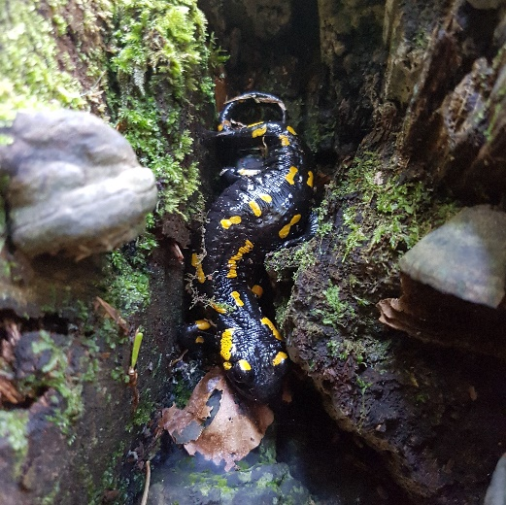
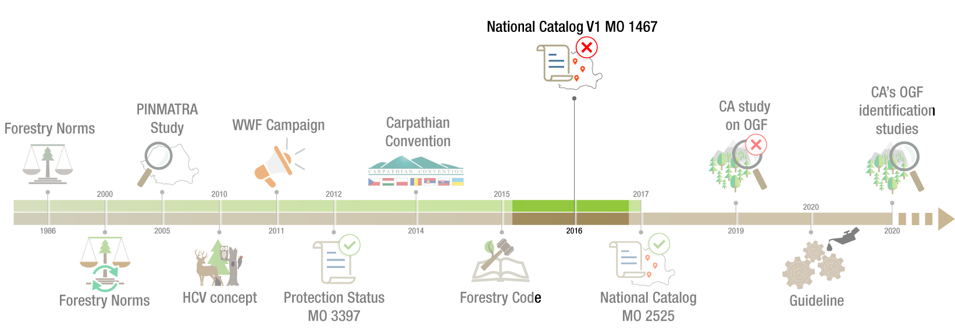
National Catalog V1 MO 1467
2016
the PINPATRA results are officially published by CA
the moratorium procedures can be formally implemented (relevant only for 15%);
forest management design entities can start considering the PINMATRA results
a national WG is formed to develop the National Catalogue procedure (NGOs, ICAS, CA, Forest universities, Forest Administrator, Experts).
the 1st version of the National Catalog of is published – MO 1417;
the MO provisions have loopholes that could undermine its scope;
the normative act is being rebuilt
Notes:
2016
Succes:
The PINMATRA results are finally, officially published by Competent Authority
Only now the moratorium procedures (2012) can be formally implemented (remember only for about 15% - for the productive forests only);
Only now forest management design entities can start officially considering the PINMATRA results;
Following the Forest Code – a national working group is formed to develop the National Catalogue procedure (engaging NGOs, ICAS, CA, Forest Universities, Forest Administrator, and other independent experts).
The first version of the ministerial order for the Catalog of Virgin Forests is published;
BUT:
→ But the provisions have loopholes that could undermine its scope; and then the normative act is being rebuilt.

Slide 14
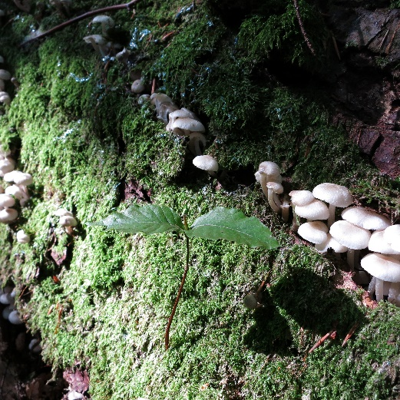
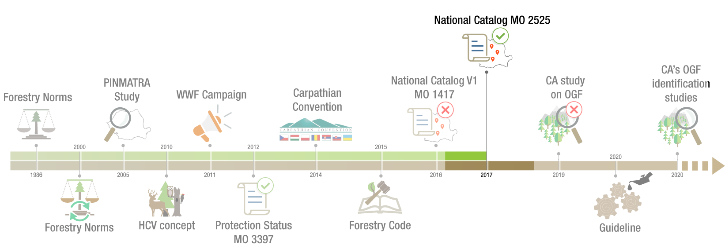
National Catalog MO 2525
2017
new participatory and transparent approach - anyone can practically get involved
are established 2 moratoriums (all PINMATRA & any formally submitted study)
new clarifications for identification criteria (based from the ones approved by Carpathian Convention)
the necessary procedures are quite complex
the process is progressing very slowly
low capacity of CA for a proper implementation
still NO functional compensatory mechanism for private owners.
Notes:
2017 – National Catalogue – Ministerial Order
Succes:
It opens a new participatory and transparent way - anyone can practically get involved!
There are established 2 moratoriums (related to all PINMATRA areas & any for any other areas that are subject of a Study that respect the legal procedure)
New clarifications for identification criteria (based from the ones approved by Carpathian Convention)
BUT:
→ The procedures become quite complex
→ The process is progressing very slowly
→ Low capacity of the CA for a proper implementation
→ Still NO functional compensatory mechanism for private owners.

Slide 15
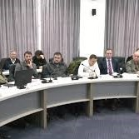
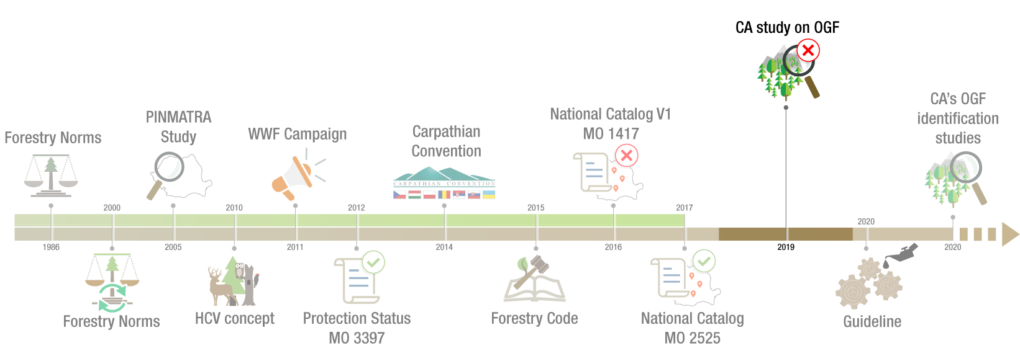
1st attempt - CA study on OGF
2019
pre-assessment of over 300,000 ha of potential OGF is coordinated by CA
participatory and transparent process
public consultation for potential OGF identification - areas to be included in the scope of the field evaluations – coordinated by CA;
public tender for the OGF identification is launched
no one participates in the auction
procedures to ensure protection of the already identified OGF are progressing very slowly
Notes:
2019 – 1st First attempt of the CA to conduct an OGF identification
Succes:
A pre-assessment of over 300,000 ha of potential virgin forests coordinated by CA
Participatory and transparent process attended by more than 80 stakeholders;
Public consultation on potential OGF areas, aiming to be complete the scope of the field evaluations
It was organize a public tender for the OGF identification
BUT:
→ No one participates in the auction
→ Still procedures to ensure protection of the already identified OGF are progressing very slowly (mainly due to lack of CA capacity)

Slide 16
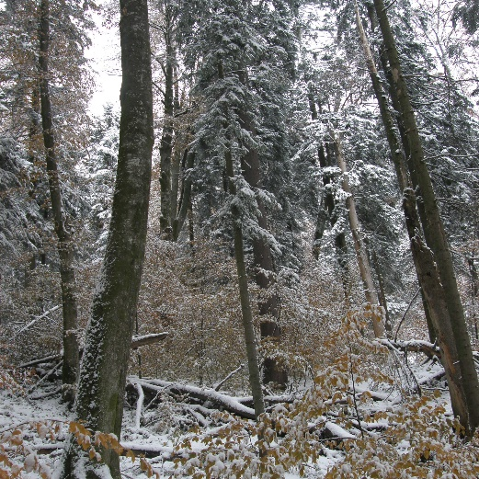
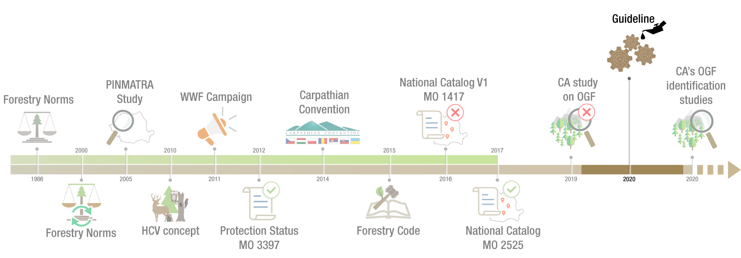
Guideline
2020
clarifying procedures aiming to have a harmonized implementation
transparent and participatory process
cannot be clarified all the terms and procedures – it’s finally a matter of assumption
COVID context slow down the process
Notes:
2020
Context:
Many of the studies are stock in bureaucratic procedures. Therefore it was considered necessary to come out with a guideline
Success:
Clarifying procedures aiming to have a harmonized implementation at national level.
Transparent and participatory process.
BUT:
→ Not all terms and procedure can be clarified in guidelines - Finally it’s a matter of assumption from the CAs representative
→ COVID context slow down the process

Slide 17
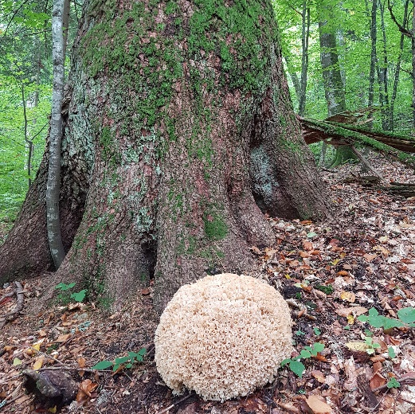
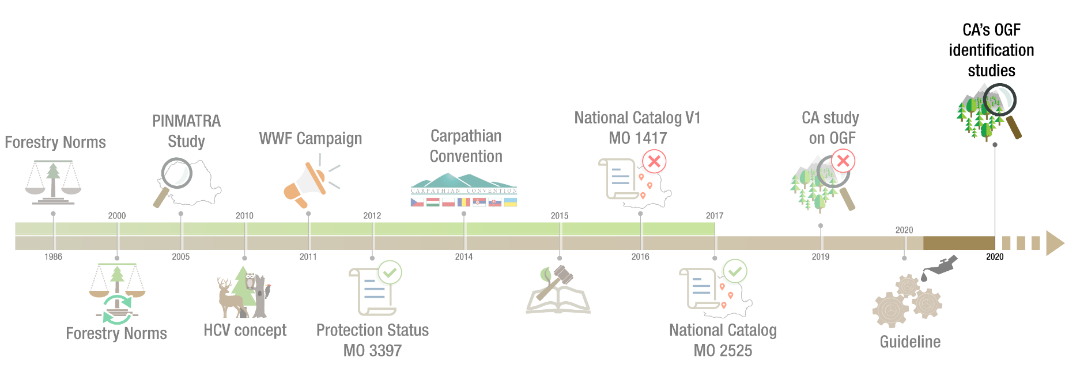
CA’s OGF identification studies
2020
transparent and participatory process
public consultation for identification of potential OGF areas to be included under the scope of the study (40,000 ha)
moratorium to put on hold any harvesting authorization
teams of specialists
according to the ToRs we still need do wait one more year.
Notes:
2020 – CA’s OGF identification Studies
Success:
Transparent and participatory process
A new public consultation to complete the scope of the Study with new proposals from interested stakeholders (40,000 ha)
Finally were selected teams of specialists – the contracts are signed
BUT:
→ According to the ToRs we still need do wait one more year until we will see its results and the identified OGF will be included in the National Catalogue.

Slide 18
National specific procedures to ensure Old Growth Forest protection - challenges & achievements
Actual status - Where we are now?
OGF in the National Catalogue:
Categorie de ecosistem | Suprafata
Cvasi-virgin forest | 36421,38
Virgine forests | 7401,98
Total | 43823.36 ha
Ongoing approval procedure: 16.509,18 ha (studies already registered)
New OGF identified: 6.500 ha (WWF studies not yet registered – WWF)
Ongoing field identification: 40.000 ha only by the CA
Still opened procedure for new identifications.
Preliminary assessment | Field evaluated area | OGF identified
600,000 ha | 155,000 ha | 60,000 ha
https://lemncontrolat.ro/
Notes:
Unfortunately in last century and especially last decades many of OGF were lost.
Nowadays our estimations is that the total virgin and cvasi-virgine area is somewhere slightly above 100.000 ha

Slide 19
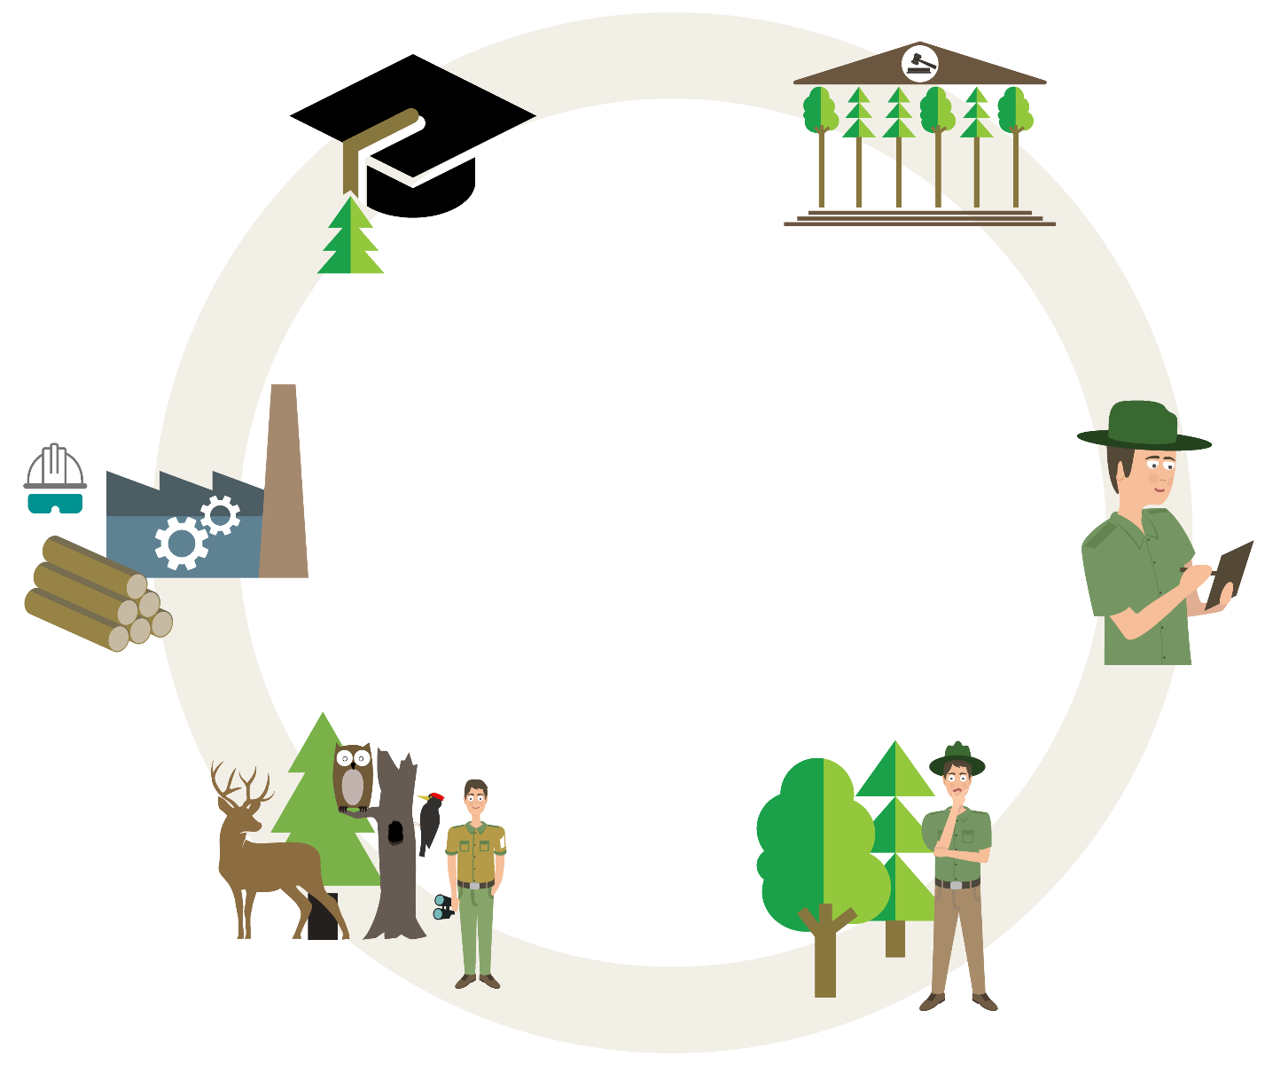
Old Growth Forest protection – way forwards
Competent
authorities
Academic
environment
Together
possible!
Civil
servants
Operators
PA administrator & NGOs
Forest owners
& administrators
Notes:
BUT we could only effectively save this heritage we have left, if WE
ALL interested stakeholders work together for this common goal since we believe
TOGETHER is Possible!

Slide 20
Old Growth Forest protection – way forwards
Competent authorities
new forest policy vision
need to speed up the implementation’s procedure
ensure functional compensation mechanisms
“additionality” needs to be clarified - in order to be able to support these efforts also from EU funds
Notes:
Addressed to Competent Authorities -
We just have a snapshot in this presentation that demonstrate Romania really need a national forest policy vision (something that is missing for yeas)
Concerning OGF we have now a consolidate specific legislation in place - we need to speed up the implementation’s procedure and
Ensuring functional compensation mechanisms for private owners is KEY
Additionality needs to be clarified - in order to be able to support these efforts also from EU funds
European funding programs take into account national legislation and we are told EU granting funds are eligible only for measures that are exceed the existing national legislation provisions.
If so, the payments programs became more counterproductive in protecting EU biodiversity;
They might favor Member States with less restrictive environmental legislation, where there may be no OGF at all!

Slide 21
Old Growth Forest protection – way forwards
Civil servants
Must strive to strengthen the “rule of law”
must believe in the need to protect these values
Notes:
Civil servants
First of all they must strive to strengthen the “rule of law”
Particularly to OGF: there are many frustrations related to this challenging process but they must believe in the need to protect these values (not only because it is written in law or because academia and civil society demand these things but because this natural heritage must be protected).

Slide 22
Old Growth Forest protection – way forwards
Forest owners and forest administrators
to have a stronger voice - compensation mechanisms derives from EU & National core values
to understand the importance of these forests and to be more open, more pro-active for enabling their protection
finally they do it also for themselves and for the local communities they belong to.
Notes:
Forest owners and forest administrators
To have a stronger voice - compensation mechanisms derives from EU & National core values as a society
To understand the importance of these forests and to be more open, more pro-active in supporting their protection (those who have not already done so far)
Finally they do it, also for themselves, and for the local communities they belong to.

Slide 23
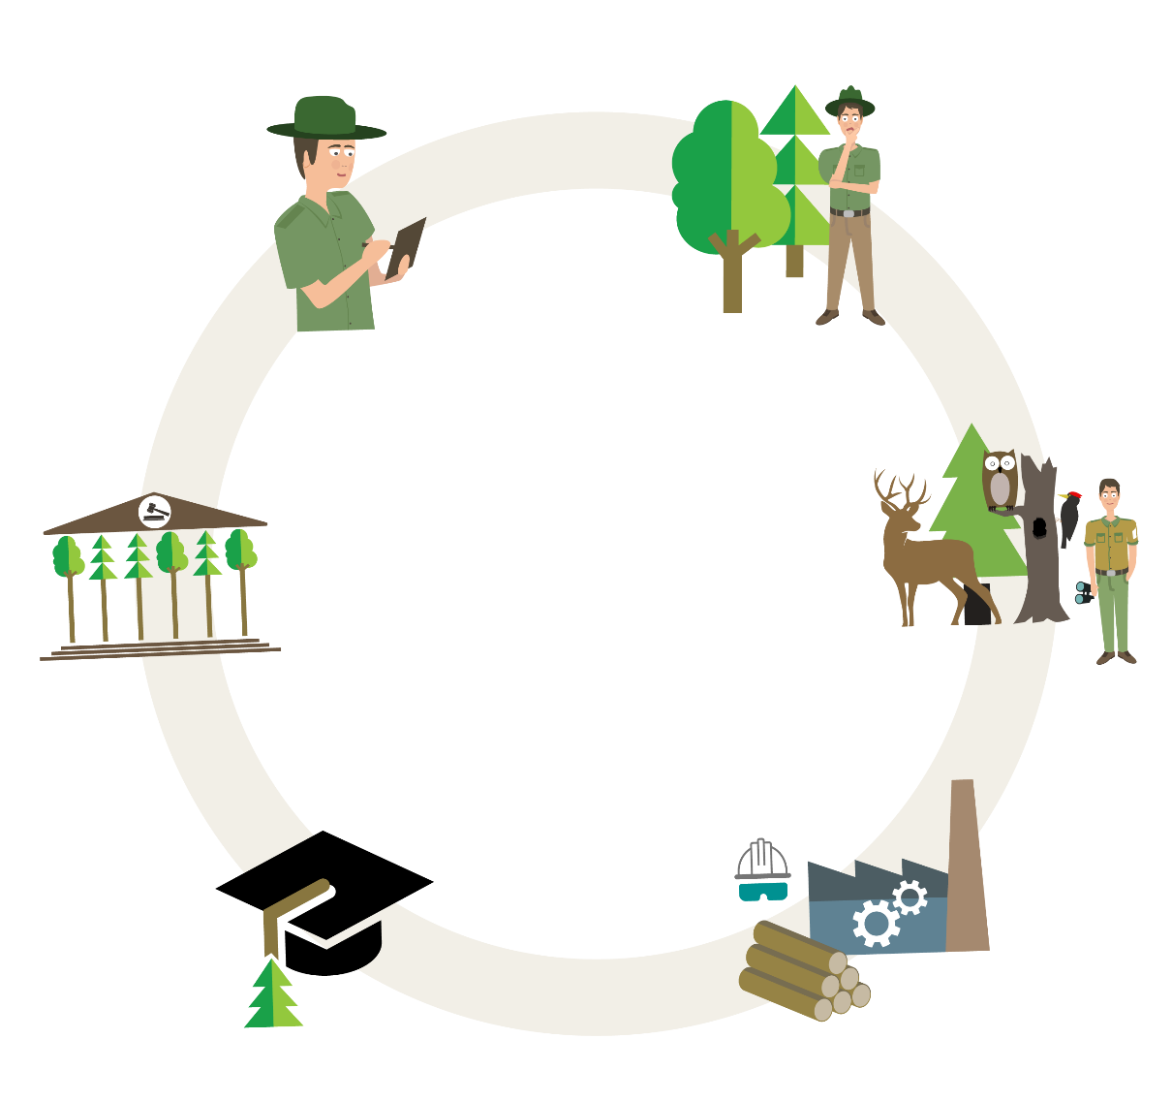
Old Growth Forest protection – way forwards
PA administrator & NGOs
beside the “Wach Dog” role – which is critical important;
be proactively involved in OGF identification and following legal procedure to ensure their protection
it is difficult but still very few have assumed this responsibility.
apart from the forest administrators who were obliged to protect these forests, very few protected areas administrator or NGOs were proactively involved following the legal procedures (less then 10 entities).
raising awareness & supporting local green business initiatives – local communities is always the key driver for their long term protection.
Notes:
PA administrators & Civil Society
Beside the “Wach Dog” role – which is critical important,
Should be more proactively involved in OGF identification and following legal procedure to ensure their protection
It is difficult, but still very few have assumed this responsibility.
Apart from the forest owners and administrators (i.e. affected stakeholders) who were obliged to protect these forests, very few interested stakeholders were proactively involved in following the legal procedures provided by the National Catalogue (less then 10 entities).
To continue raising awareness of their importance & while supporting local green business initiatives; N.B. local communities are always the key driver for their long term protection.

Slide 24
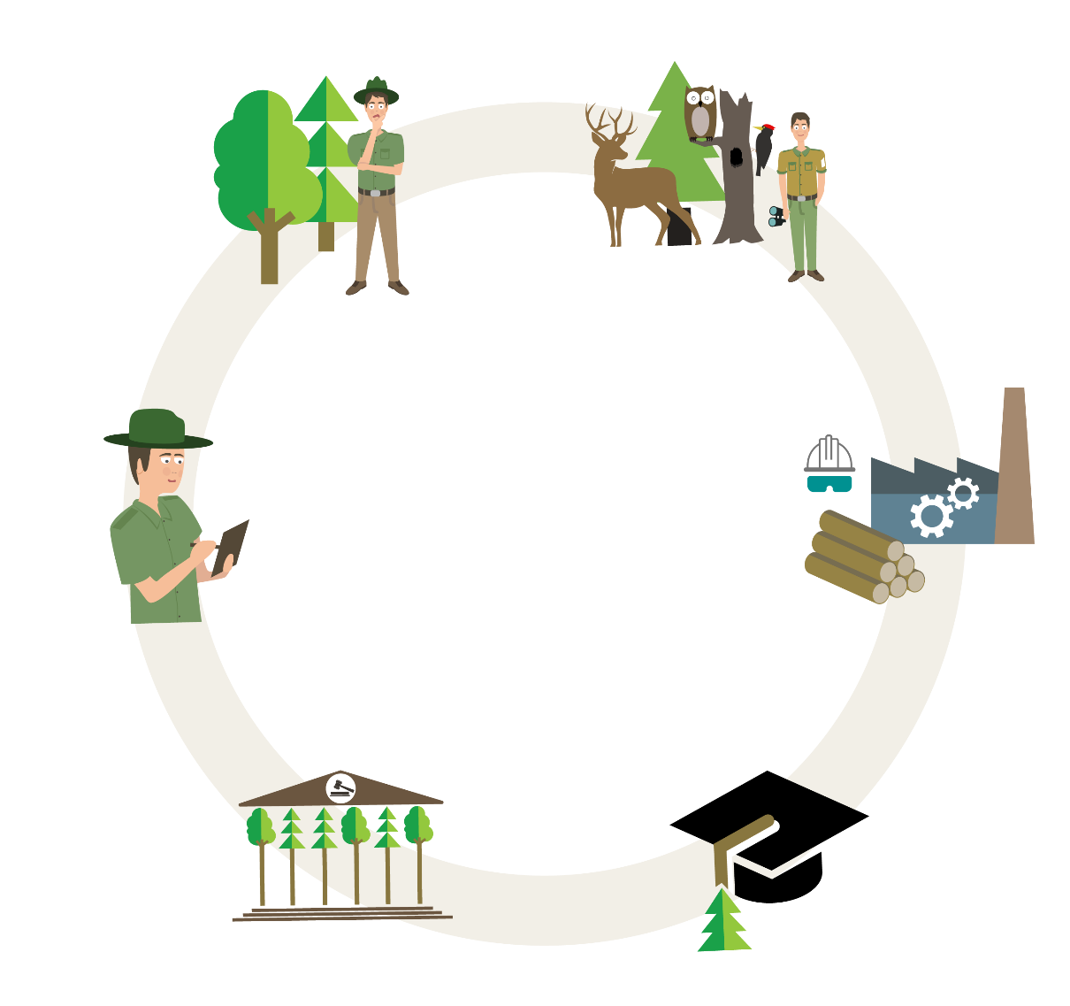
Old Growth Forest protection – way forwards
Operators
Enforce robust Due Diligence System
Notes:
Operators
Enforce Robust Due Diligence System

Slide 25
Old Growth Forest protection – way forwards
Academic environment
To decipher the secrets of the forest universe;
To emphasize their importance;
Help us learn how to better manage our forests
Notes:
Research and Academic environment
To decipher the secrets of the forest universe;
To further emphasize their importance;
Help us learn how to better manage our forests.

Slide 26
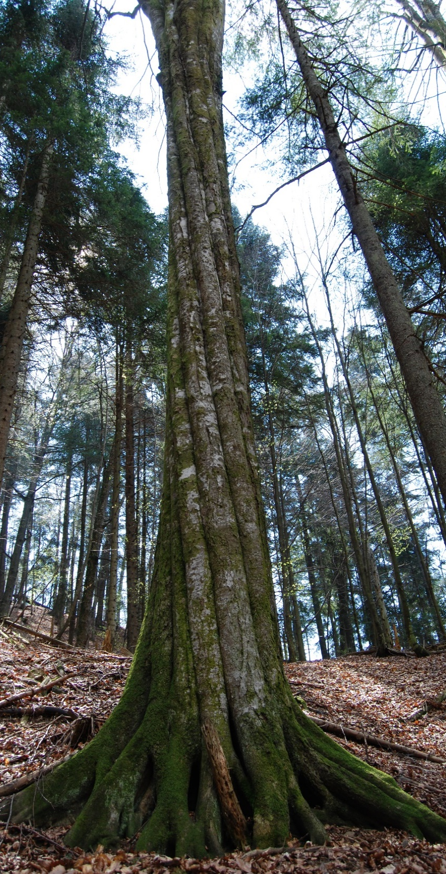
Thank you!
Radu VLAD
Forest Regional Project Coordinator
WWF - România
rvlad@wwf.ro
© Chiș Timur / WWF
Notes:
Thank you!

